Slide 1

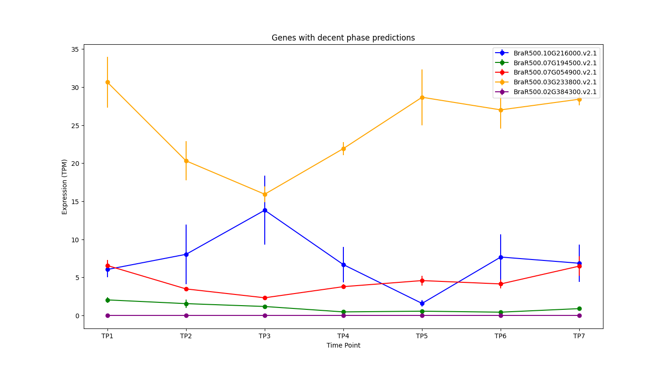
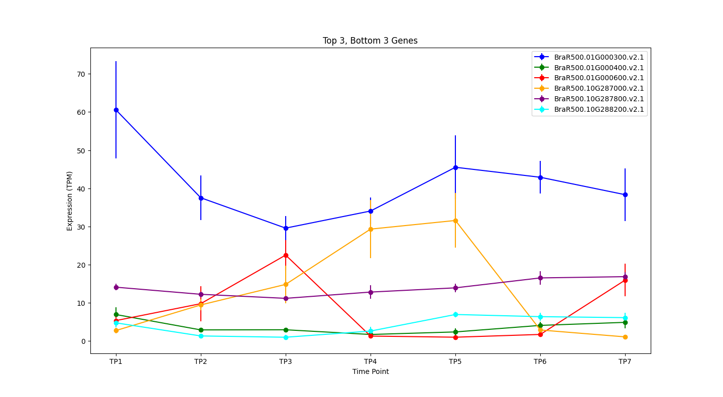
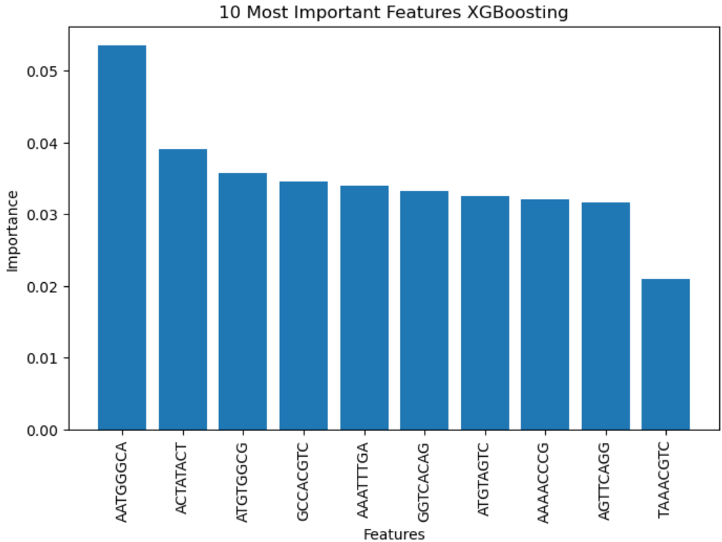
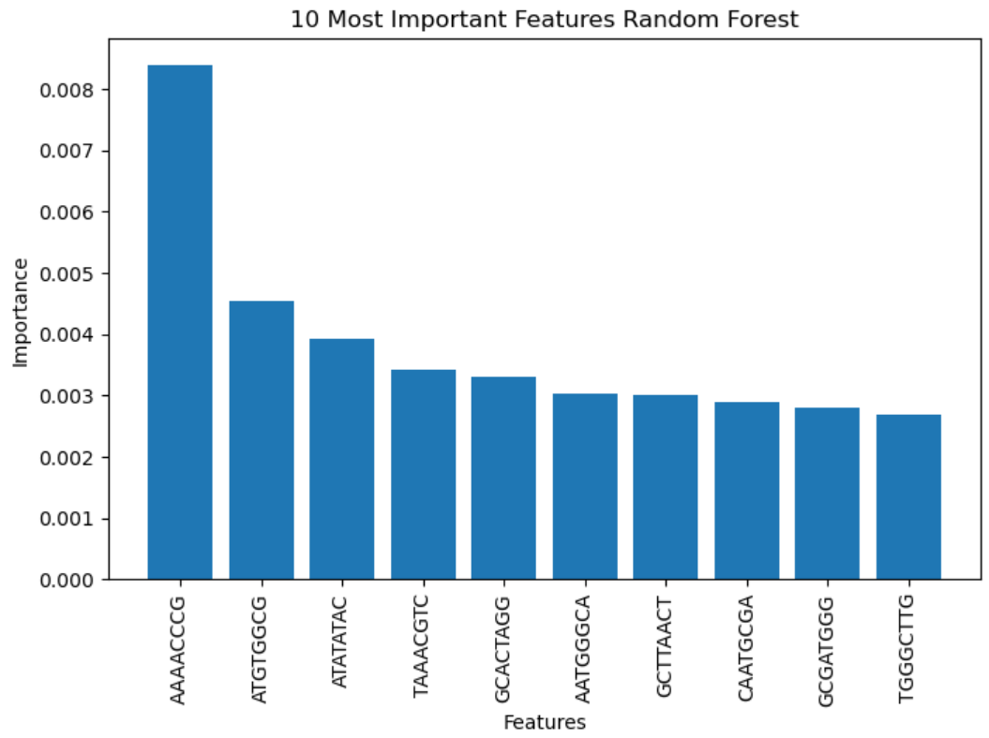
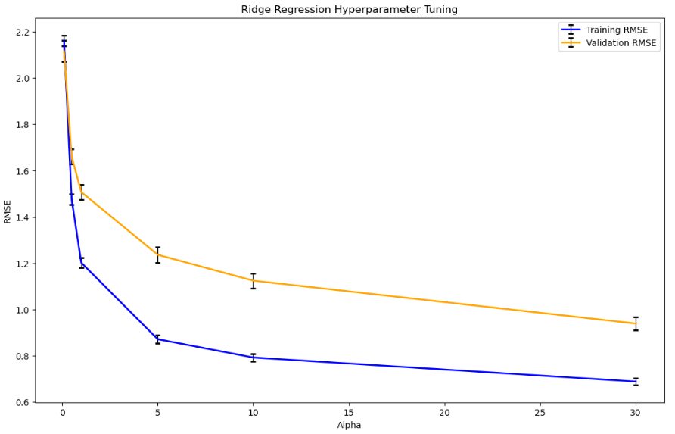
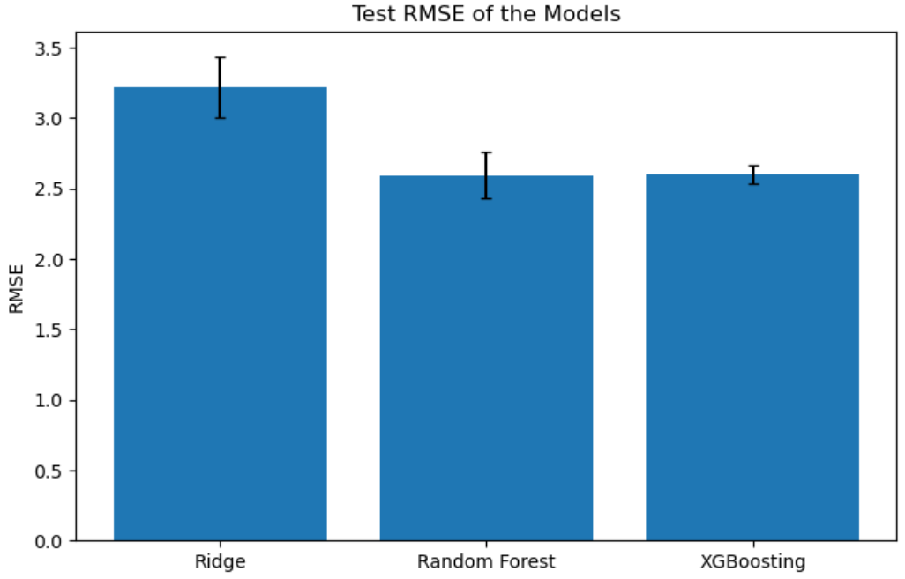
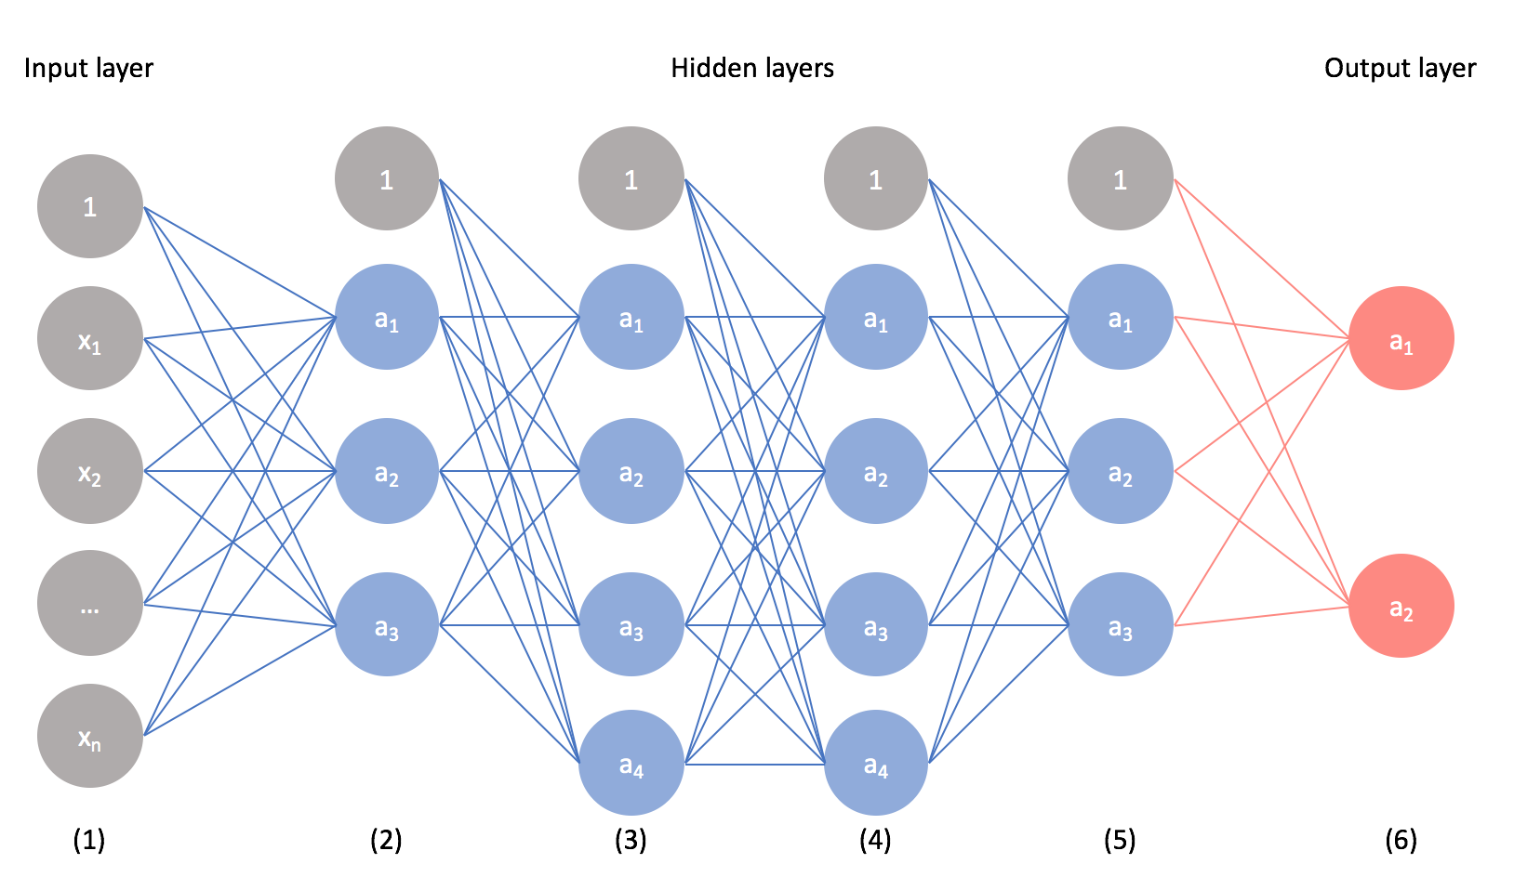
Identifying conserved binding sites regulating circadian patterns in Brassica rapa
Joan Barreto, Jennie Cheng, Ekin Ercetin, Plinio Rosales, Grace Wurgler
Introduction
Circadian rhythms, “biological clocks,”
are estimated to control ~35% of the
Arabidopsis transcriptome, a close
relative to B. rapa¹. Plant response to
stress is influenced by circadian genes².
Understanding transcriptomic and
metabolomic responses to stress may
facilitate the development of crops that
are more resilient to changing climates².
Temporal Expression of Clock Genes
Goals
Identify cis-regulatory elements within a 2 kb upstream region across morphotypes of B. rapa
Identify conserved binding sites for transcription factors regulating circadian genes
Predict circadian patterns of specific B. rapa genes
Figure 1.Circadian Genes
(a) We selected clock genes based on their phase prediction accuracy in the output file generated by conventional machine learning algorithms.
(b) From the output file generated by MetaCycle, we identified the top three and bottom three clock genes based on their respective scores and plotted them.
(a)
(b)
Methods
Results
A Python script that “one-hot encoded” features of each input 2kb region was written.Sklearn was used to split the data into training and test sets. Feature importances analysis and cross validation were performed for each model.
Feature Importance Analysis
Three sequences were identified in the 10 most important features for the models tested.
These sequences were AATGGGCA, ATGTGGCG, TAAACGTC.
These were identified as potential binding sites based on the ML analysis
Feature Importance Analysis
Three sequences were prevalent in the top 10 most important features
Random Forest Regressor
From the sklearn package, the “RandomForestRegressor” function was used as a model. Random Forest combines the output of multiple decision trees to reach a single result. 3-fold cross validation was performed on this model.
Ridge Regression
The Ridge function from the sklearn package was used. 10-fold cross validation was performed on the L2 regularized linear regression model “Ridge” varying the hyperparameter “alpha” from 0.1 to 30 (Figure 2). This was done for robustness of the model.
Support Vector Regressor
The SVR function was run from the sklearn package. Linear and a radial basis function (rbf) were tested and a hyperparameter C with value 1. 3-fold cross validation was performed in this model.
XGBoost
The Extreme Gradient Boosting model was trained (XGBoosting). This models consist of an ensemble various decision trees that were trained in parallel. 3-fold cross validation was performed for this model.
Figure 2. Top 10 most important features for the RF and XGBoost models.
Neural Networks
PyTorch was used to train neural networks. 256 neurons were used for each hidden layer with a ReLu activation function. Different learning rates, hidden layers, and hyperparameters were tested to ensure a robust model.
Figure 3.Hyperparameter tuning Ridge L2 Regularized
Figure 4.Test RMSE of three models tested
[3]
Conclusions and Future Directions
Overall, the results show that the XGBoost and RF models performed the best in predicting the circadian phase, followed by the SVR and ridge regression models. We found several significant binding sites that may regulate the circadian rhythm in Brassica rapa, which can provide insight into the regulation of circadian rhythms and lead to the development of crops that are more resilient to changing climates. As a direction for future research, we plan to investigate potential improvements to our phase prediction accuracy. Specifically, we will explore hyperparameter tuning for the conventional machine learning algorithms and neural networks utilized in our analysis to address issues related to overfitting. This will allow us to further optimize our methods and potentially improve the accuracy of our results.
References
Michael, T. P., & McClung, C. R. (2003). Enhancer Trapping Reveals Widespread Circadian Clock Transcriptional Control in Arabidopsis. Plant Physiology, 132(2), 629–639. https://doi.org/10.1104/pp.021006
Greenham, K., Guadagno, C. R., Gehan, M. A., Mockler, T. C., Weinig, C., Ewers, B. E., & McClung, C. R. (2017). Temporal network analysis identifies early physiological and transcriptomic indicators of mild drought in Brassica rapa. ELife, 6, e29655. https://doi.org/10.7554/eLife.29655
Jordan, J. (2019, April 2). Convolutional neural networks. Jeremy Jordan. Retrieved May 2, 2023, from https://www.jeremyjordan.me/convolutional-neural-networks/

